Slide 1
SPOTIFY
Data Pipeline and ETL

Slide 2
Business Objective
Client wants to collect top global songs every week available on spotify
bill board.
WHY?
To understand what type of songs are trending.
What type of albums are trending and who is the artist.
To accomplish this client asked to create ETL pipeline

Slide 3
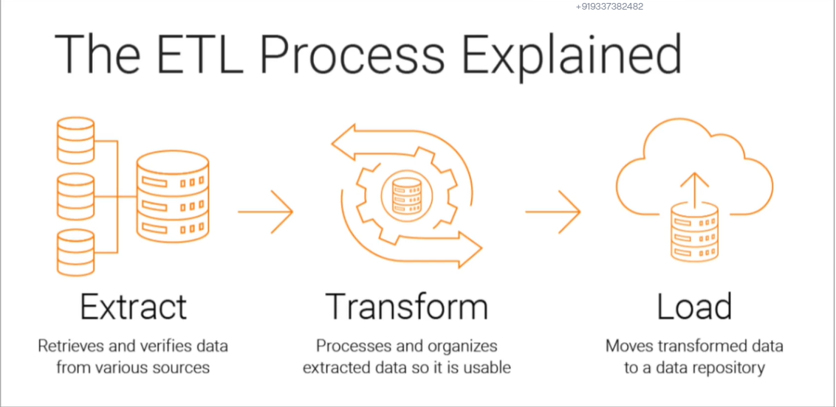

Slide 4
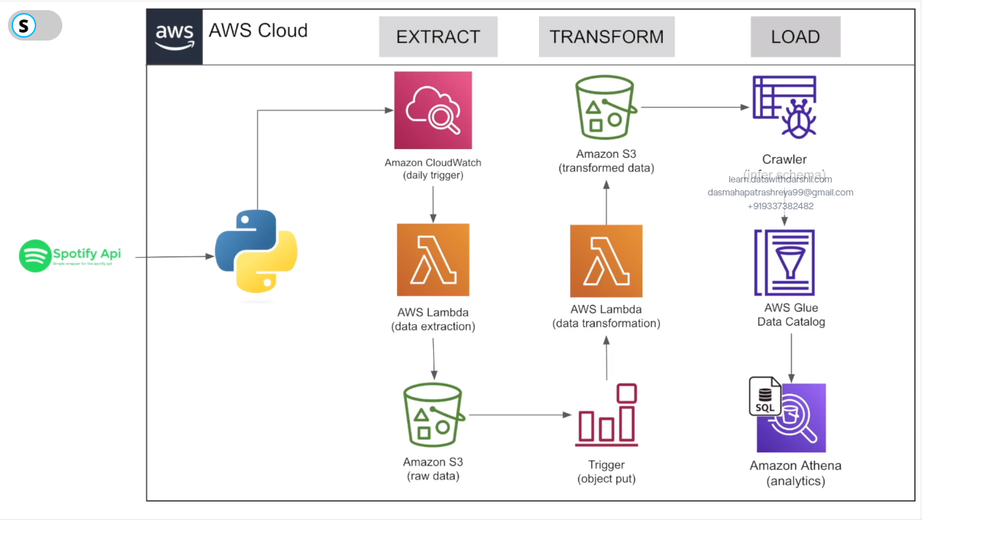

Slide 5
Overview of the Architecture.
Spotify API: Helps to extract spotify data and make use of it. We will register our application on this so that we can get client ID and the secret key ID so that we can use this to collect data from API. We will use spotify package to extract data from API.
EXTRACTION
Amazon Cloud Watch: We want to run the code in certain intervals. To schedule these runs we use this.
AWS Lambda: We will deploy are code here. It is a compute service which deploys the code on event basis. Here this code will extract raw data from spotify.
Amazon S3:This is object storage that will store the raw data extracted in AWS Lambda. S3 stores different type of files.
TRANFORMATION
Trigger: Whenever S3 collects any raw data it will trigger jobs to transform the raw data as per requirement.
AWS Lambda: Here the code will transform the raw data to required form.
Amazon S3: Here the transform data will get stored.
LOADING
Crawler: Will go through each file and see how many columns it has, data types of it etc.
AWS Glue Catalog: It stores the information of the data,i.e, number of columns, data types etc.
Amazon Athena: To run sql on top of these data.

Slide 6
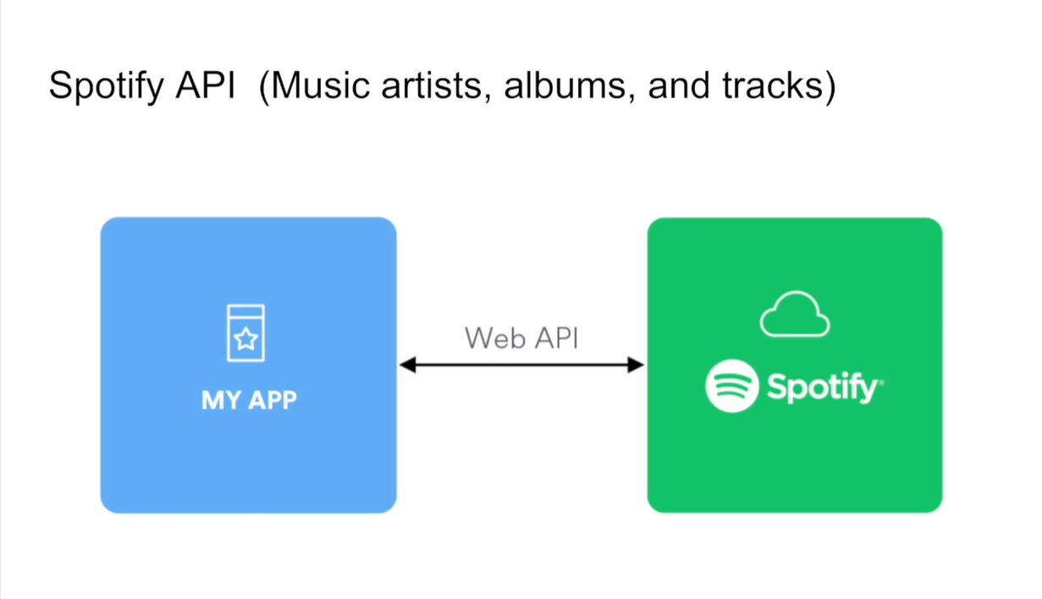
Spotify API
1.On this API we mainly have artist, album and track/song information.
2.MyApp(python application) will get connected to Spotify API using python package.

Slide 7
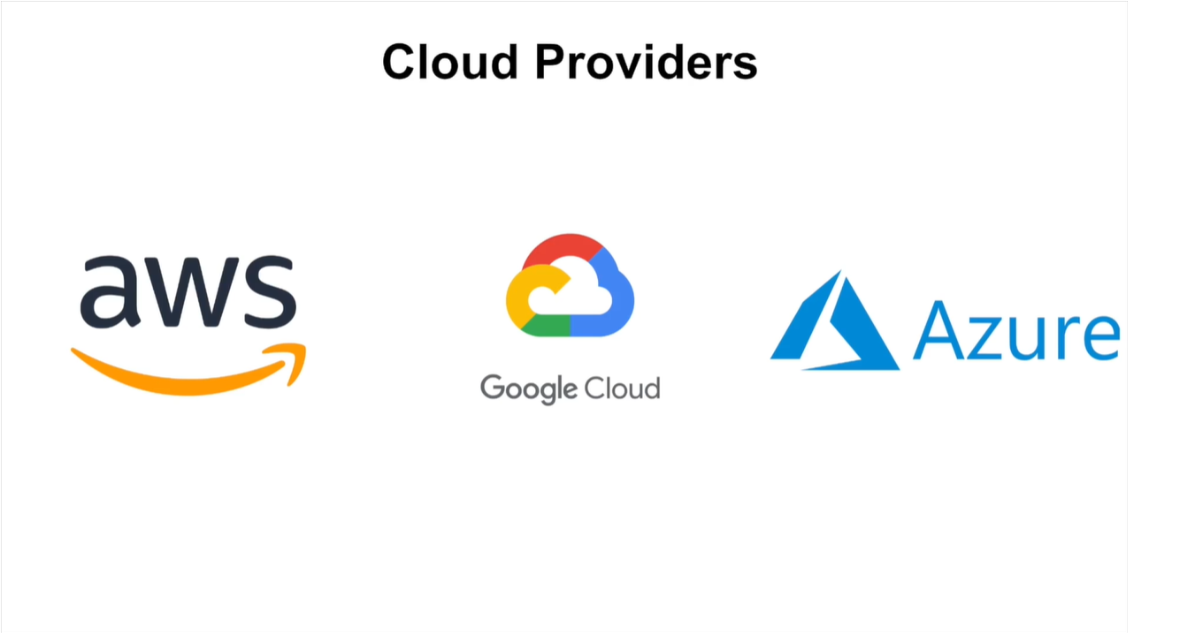
We can choose whatever cloud service to do this development but here we will move ahead with AWS and need not to worry it provides 1yr free services up to certain limit.

Slide 8
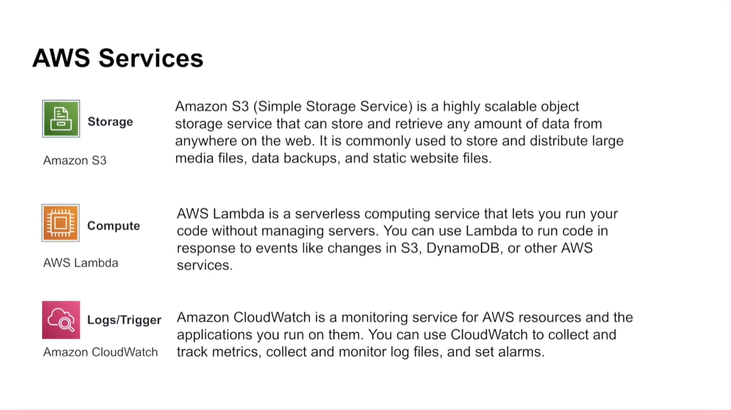
Note: Instead of AWS Lambda we can opt for airflow or informatica but here we have chosen this and other services for this project which is completely server less.

Slide 9
